Slide 1
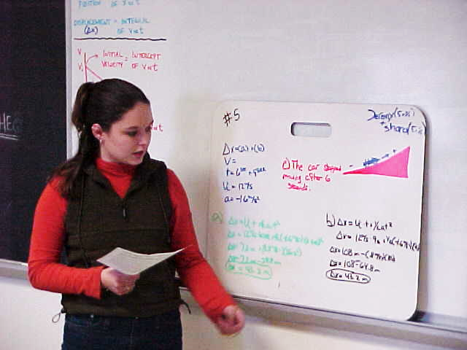
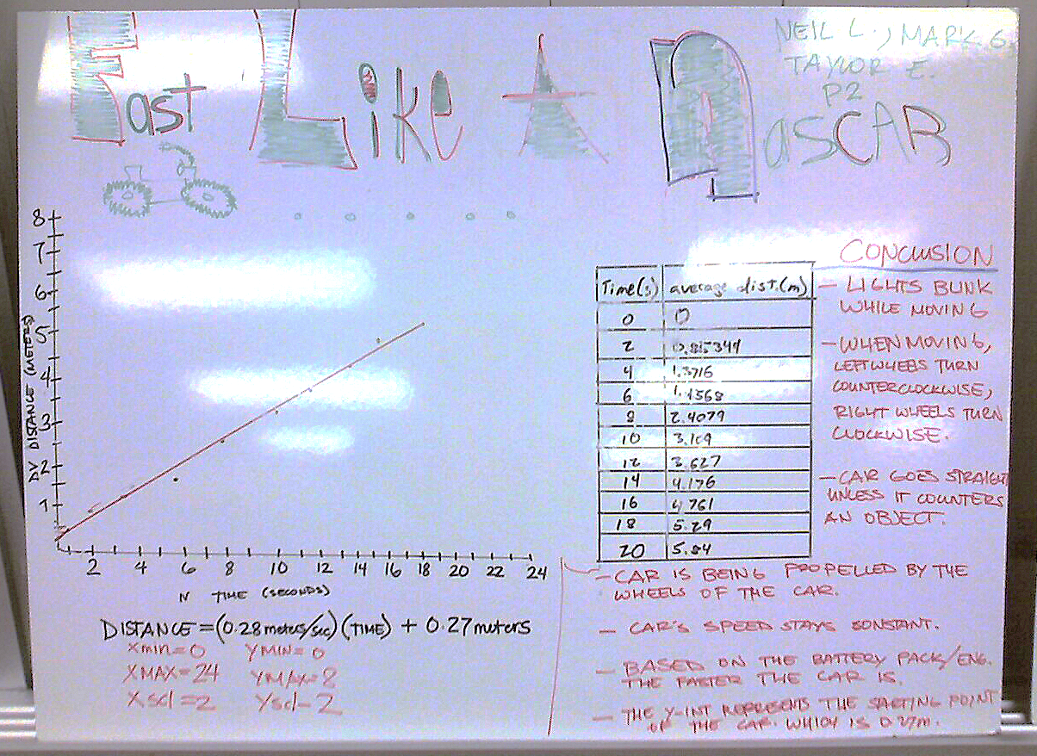
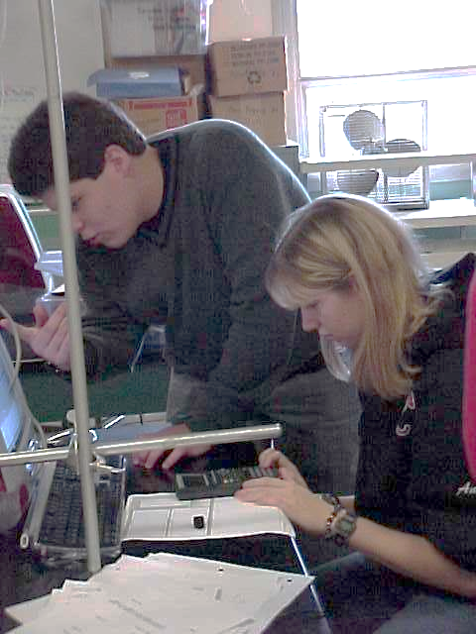
Introduction to Modeling Instruction
The Bouncing Ball Lab as an introductory physics lab (9:30-11:00)
and
The Buggy Lab as an inquiry activity to develop the velocity concept. (11:30-1:00)
Lee Trampleasure, Sacred Heart Cathedral Preparatory, SF, CA

Slide 2
The Modeling Instruction Cycle:
The class observes a phenomenon, and is presented with a challenge.
In groups and with all-class check-in, students develop investigations to explore that phenomenon.
Students conduct their investigation.
Students develop models that explain their observations: Emphasis is on multiple representations of their results:
Graphing
Written
Mathematical
Students share their model with other groups, and the class searches for consistencies across models, and differences.
The class agrees on a consensus model, and the experimental design pieces that produced differences.
Students are presented with a challenge that “breaks” the model, and the class develops descriptions of the limits of the model.

Slide 3
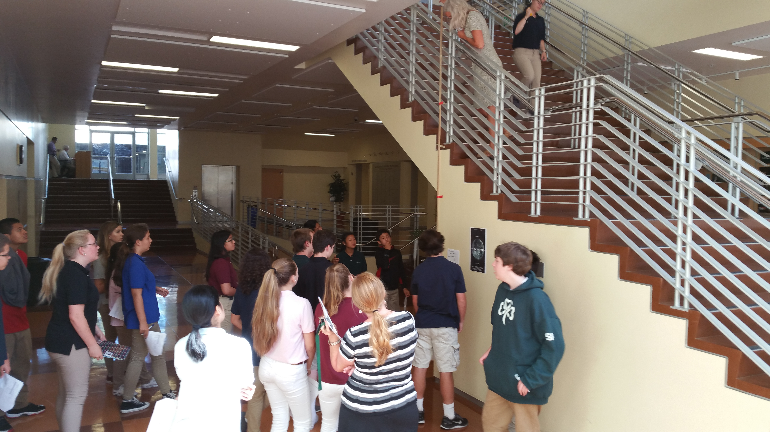
The Bouncing Ball challenge
The challenge in the classroom is from 1.5 meters, and all groups get good results.
After that, they are asked to predict the bounce height of their ball if it is dropped from 6.5 m (or whatever high drop location you can find at your school!).
The test is on!
In this case, the dense balls tend to get good results, but the air-filled balls tend to get bad results. This leads to a conversation of why some balls don’t get as good results.
Students raise suggestions like “air resistance” and “terminal velocity” and “the ground is different.” Some of these we can test, and others are “we’ll come back to this lab when we get to that concept.”

Slide 4
The Buggy Lab challenge
After developing the concept and equation for velocity, students are challenged to determine the location of the collision of two cars started four meters apart.
Each group is partnered with another group, and given one last chance to measure the velocity of their car (“why” I ask, and some come up with responses like “the batteries may have gone down).
When ready for the challenge, students place a piece of paper on the ground, marking where the cars will collide.
The test is on!

Slide 5
Resources
American Modeling Teachers Association: www.modelinginstruction.org
My personal blog, with resources for teaching: trampleasure.net/lee
Follow me on Twitter: @LeeTramp
AMTA website
My contact info

