Slide 1
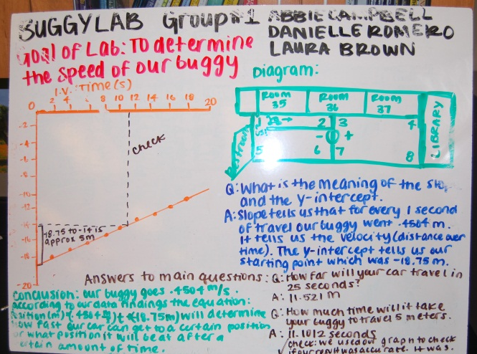
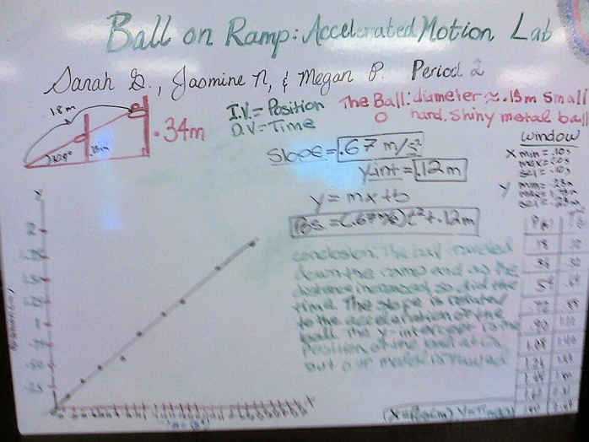
Whiteboarding
A powerful tool for learning.

Slide 2
Whiteboarding is about sharing information
1) Your whiteboard contains information about how you conducted your lab:
Any conditions your group had to decide on (e.g. bottom or top of ball).
Descriptions of your object that would distinguish it from others (e.g. type of ball, color).
A small sketch of your experimental design.
2) Your whiteboard contains your results presented:
As a graph
In an equation (with variable and units on all numbers)
In a written sentence or two.
(Notice it does not contain a data table.)
Don’t squeeze so much information on your whiteboard that people can’t see it from across the room.

Slide 3
Sample whiteboard 1

Slide 4
Sample whiteboard 2

Slide 5
Board Meetings
Once all white boards are completed, we will display them for the entire class to view. During the Board Meeting, we will evaluate them in the following order:
Look for similarities in the boards: What trends are consistent throughout?
After we have found and discussed the similarities look for differences between the boards.
We will discuss these differences and draw conclusions from them.
Take notes in your personal lab notes during the Board Meetings.
Board Meetings are student directed; I will take a minimal role in directing them.

Slide 6
How correct does it need to be?
A whiteboard should represent your data and conclusions clearly and accurately.
You may find that you make mistakes in your conclusions—this is part of the learning cycle.
Whiteboards are not graded for accuracy, but rather for ‘participation’ – they designed for sharing information as part of the process towards your final conclusions.
If you find you have made mistakes in your data presentation and/or conclusions, make a note of these in your lab notes.

